Slide 1
Data Science Basics in R:
Day 2: Data management

Slide 2
Goals for today
Understand what data management is
Identify some interesting sources of healthcare and public health data (if you don’t already have your own)
Load and clean your first dataset in R
Learn about and implement best practices for:
documenting your code
data dictionaries
Doing reproducible research in R

Slide 3
What is data management

Slide 4
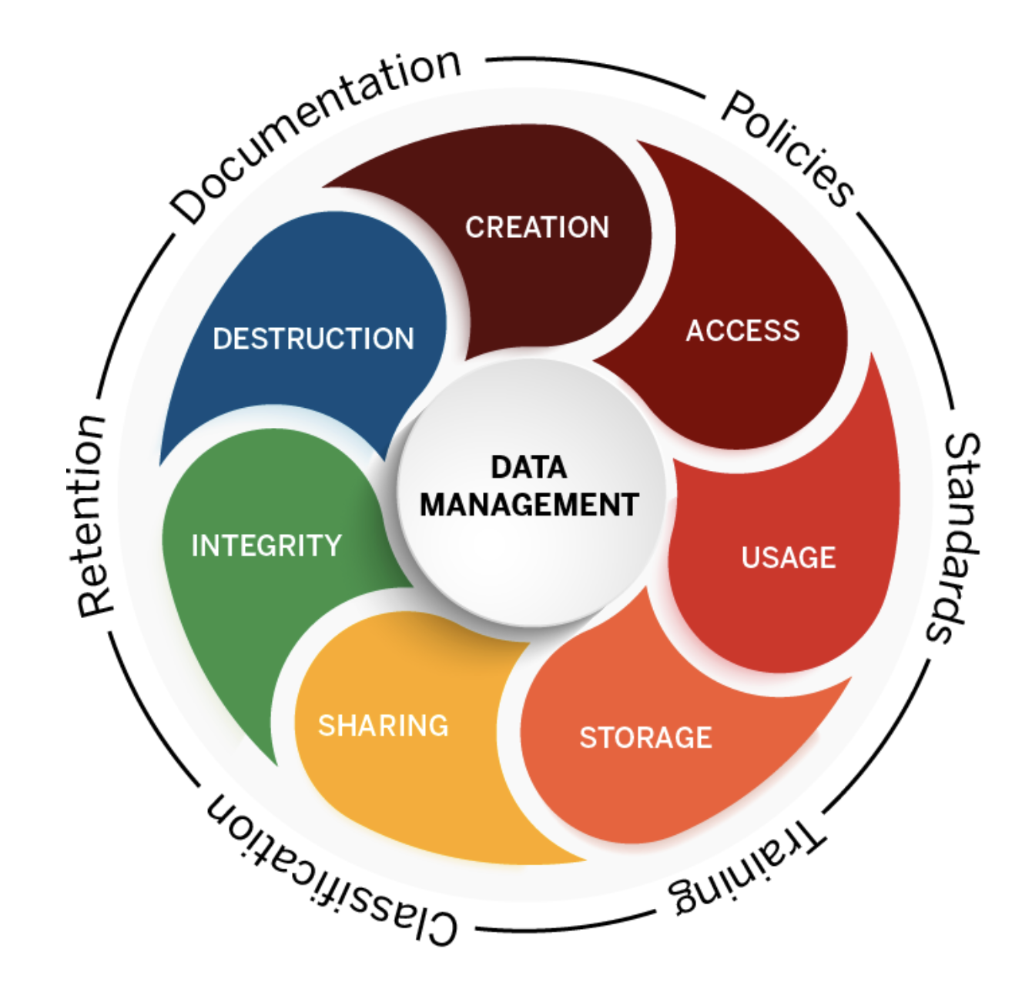
Data management
Data management is the practice of creating, maintaining, documenting, and securing data.
It includes data cleaning, among many other tasks.
Notes:
Graphic from https://datamanagement.iu.edu/

Slide 5
What does data cleaning involve?
Better question: what doesn’t it involve?
Data cleaning tasks depending on what types of data you’re working with and where you got them!
Identifying and addressing missing values
Fixing “weird” characters
Combining multiple datasets
Deduplicating lists
Identifying other discrepancies…

Slide 6
Reading in a new dataset

Slide 7
Raw data files
We’re going to talk about structured, flat files today, but there are many types of data that R can work with!
Excel: proprietary file format (Microsoft), but common
CSV: comma-separated values
TSV: tab-separated values

Slide 8
Functions to load data
Excel: read_excel()
CSV: read.csv()
TSV: read.delim()
Example: read.delim("countries.tsv")

Slide 9
Functions to load data
Excel: read_excel()
CSV: read.csv()
TSV: read.delim()
Example: read.delim("countries.tsv")
Let’s talk briefly about file paths…

Slide 10
Data Structures in R

Slide 11
Vectors

Slide 12
Data Frames

Slide 13
Data cleaning

Slide 14
Data cleaning

Slide 15
View your dataset in RStudio

Slide 16
Check for missing values

Slide 17
Ask questions about your data

Slide 18
Some useful sources of global public health data

Slide 19
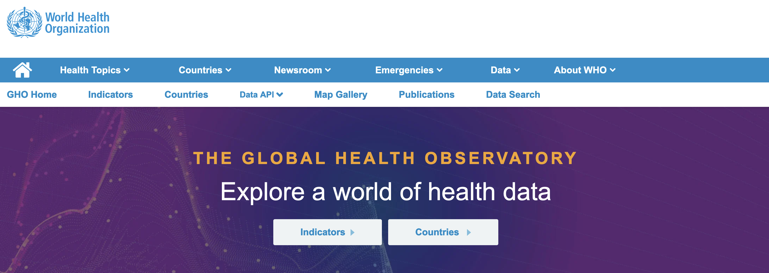
WHO Global Health Observatory
https://www.who.int/data/gho

Slide 20
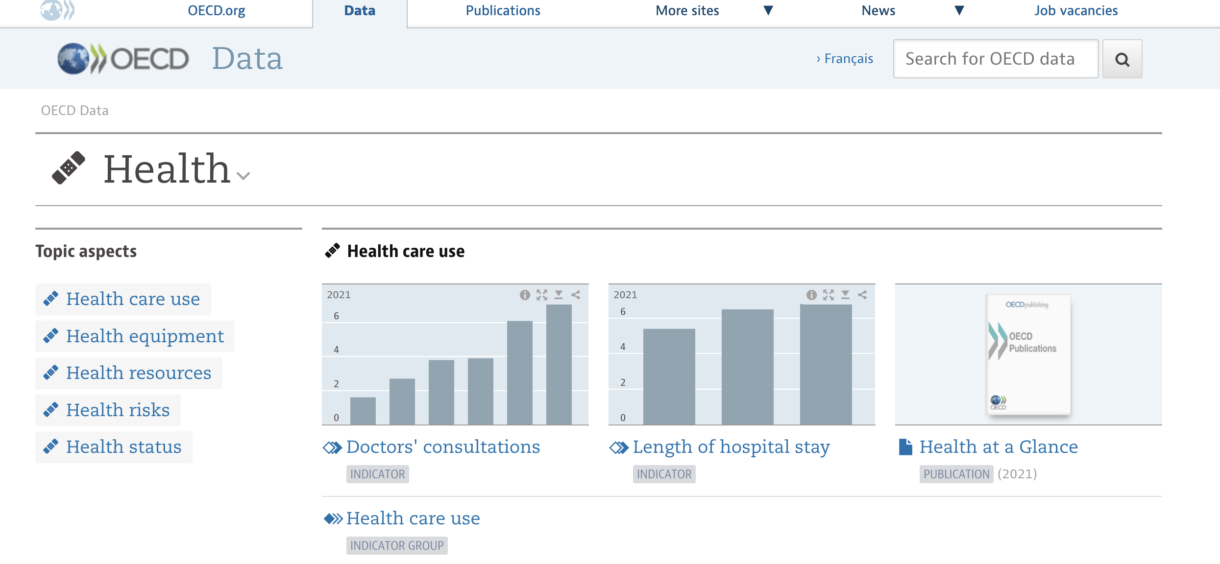
OECD Health Data Repository
https://data.oecd.org/health.htm

Slide 21
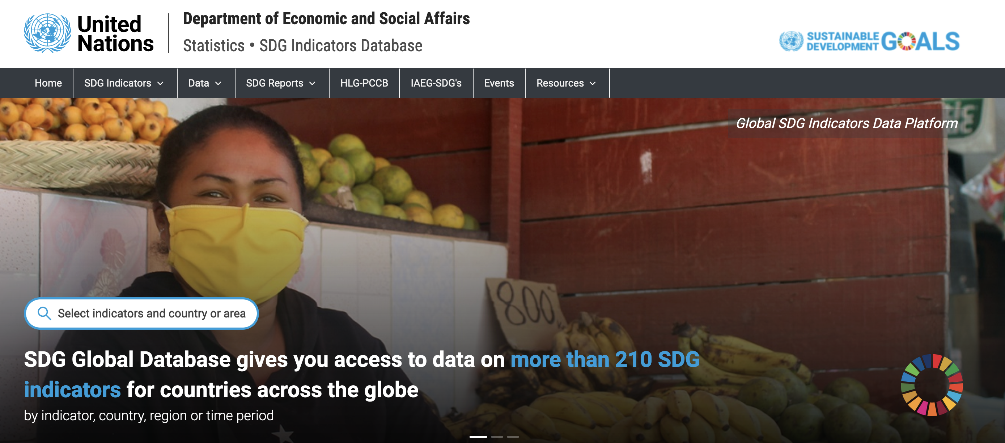
UN SDG Global Database
https://unstats.un.org/sdgs/dataportal

Slide 22
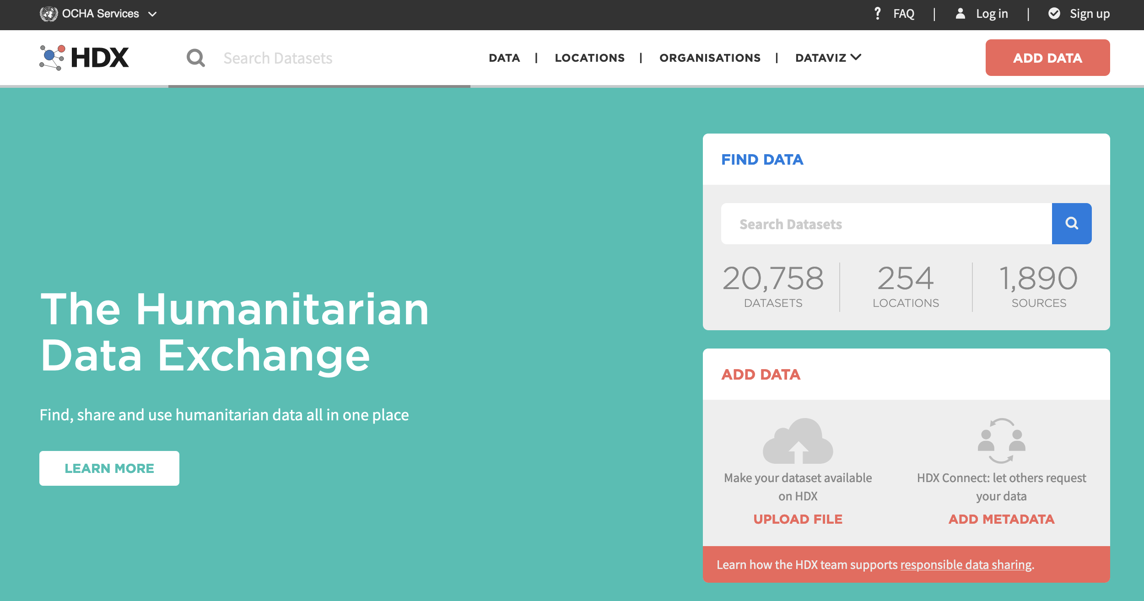
OCHA Humanitarian Data Exchange
https://data.humdata.org/

Slide 23
Documenting your data, code, and results

Slide 24
Documentation

Slide 25
Documenting datsets

Slide 26
Documenting code

Slide 27
Reproducible results

Slide 28
Open-source science

Slide 29
Thank you!
See you tomorrow.
Please come with a fully charged laptop.
Lecture and course material adapted from Intro to R materials created by Alex Douglas, available online here, with corresponding free online textbook.

